Slide 1
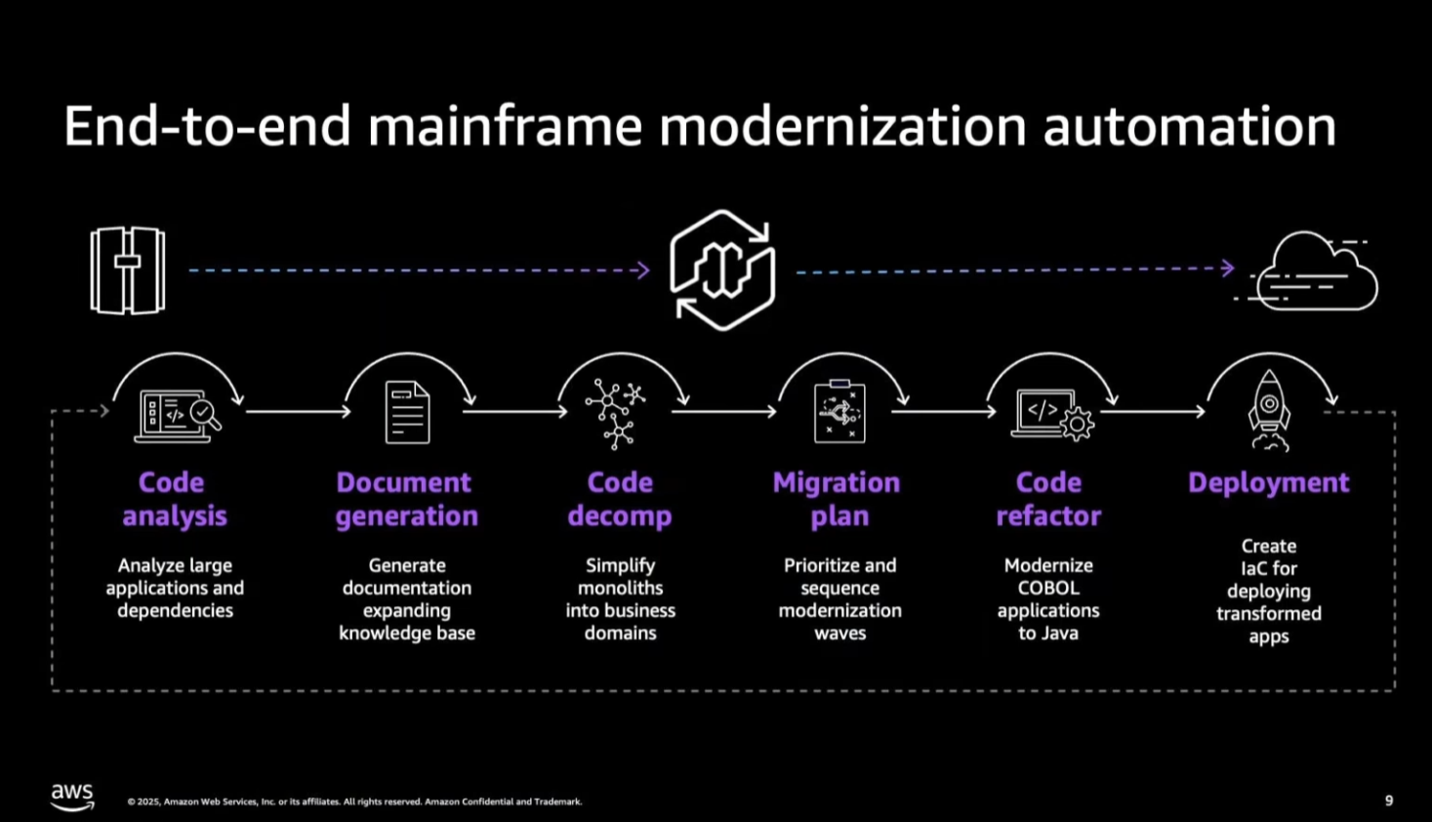
AWS Transform

Slide 2
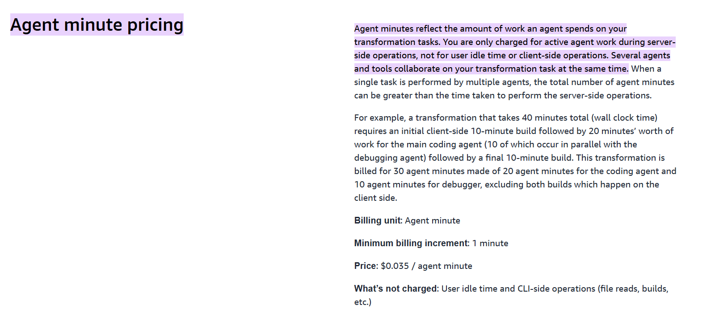

Slide 3
Code Analysis
What it does: The process begins by analyzing the legacy codebase (e.g., COBOL, JCL) to identify file types, dependencies, and redundancies [08:17].
Outcome: It creates a "dependency graph" that maps out the interconnectedness of the system, helping teams understand the complexity before starting [12:40]. It also identifies missing components or duplicate files that need to be resolved [24:44].

Slide 4
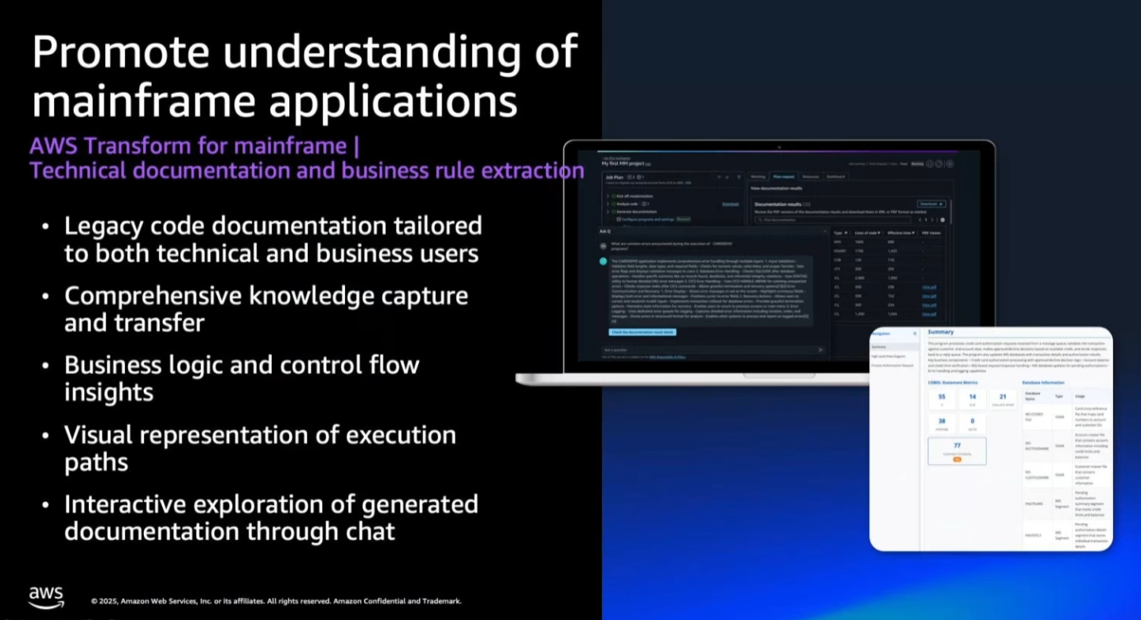
Document Generation
What it does: The service generates natural language documentation for both technical developers and business users.
Technical Docs: Detail how data is accessed, control flows, and program logic for developers maintaining the code [10:34].
Business Rules Extraction: Extracts and visualizes business logic so non-technical users can understand what decisions the software is making [11:12]. This helps in deciding what logic to keep or reimagine.

Slide 5
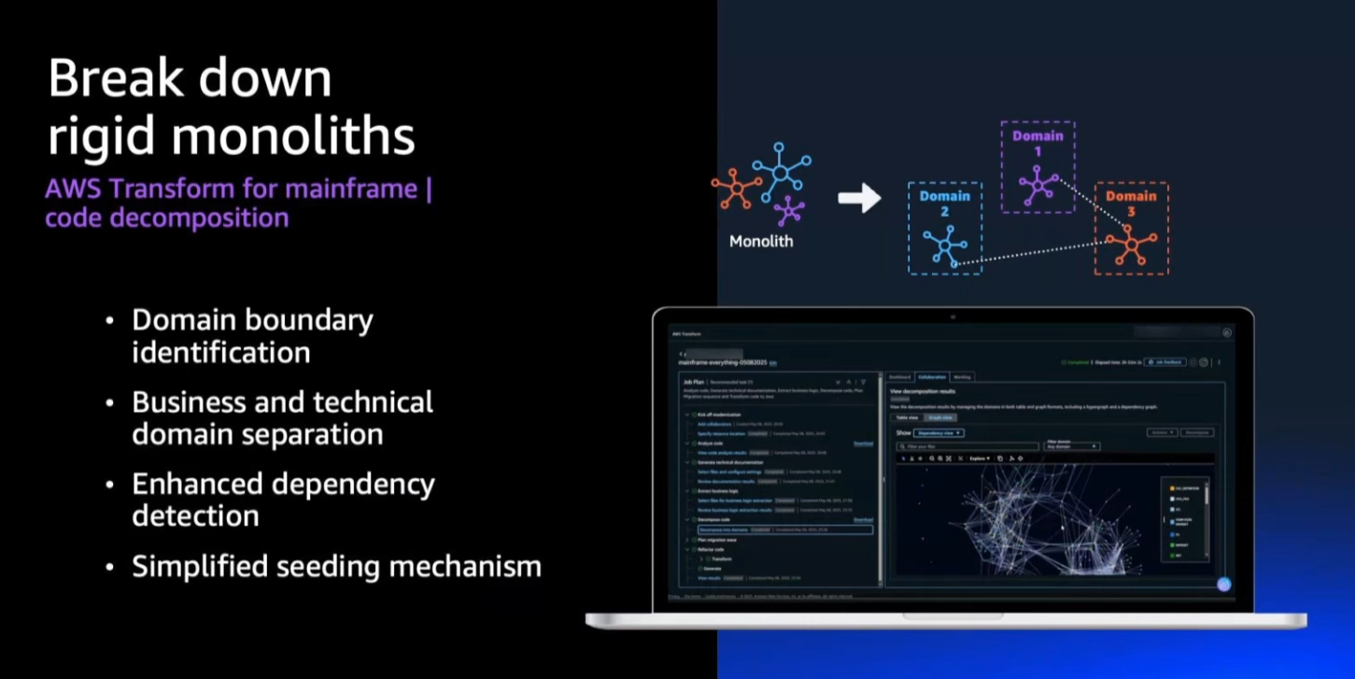
Decomposition
What it does: It breaks down the monolithic mainframe application into smaller, distinct business domains (e.g., "Accounts," "Transactions") to plan the migration [12:02].
How: It uses automated detection combined with human input. A user can provide "seeds" (hinting at which files belong to a specific domain), and the AI uses semantic search to group related files and boundaries automatically [32:05].

Slide 6
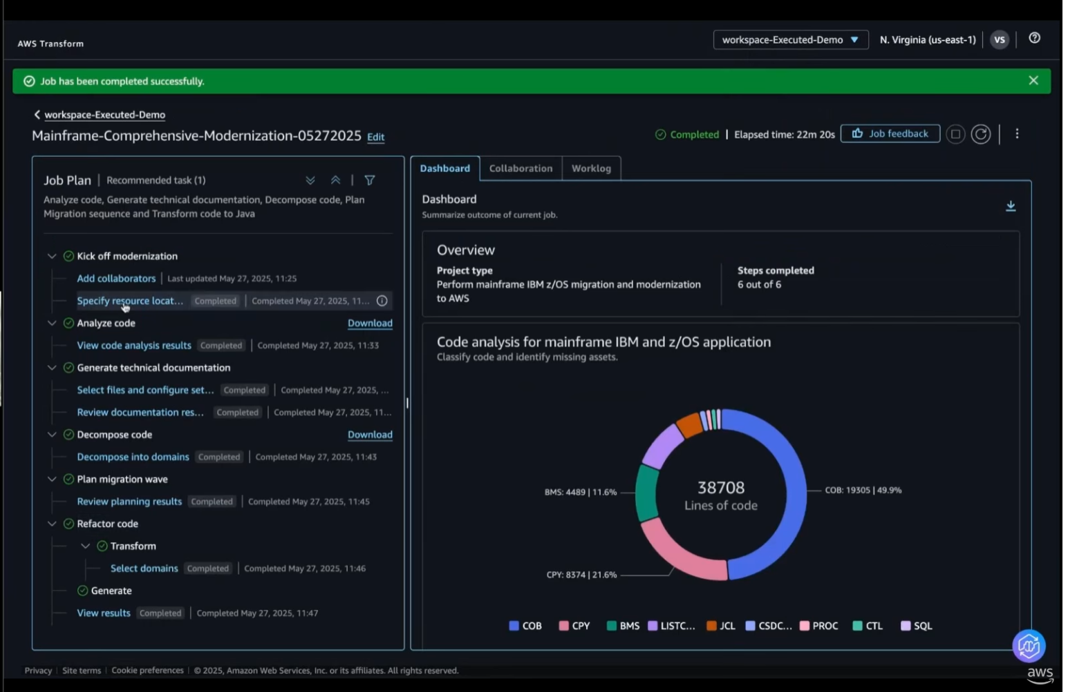
Comprehensive Code analysis

Slide 7
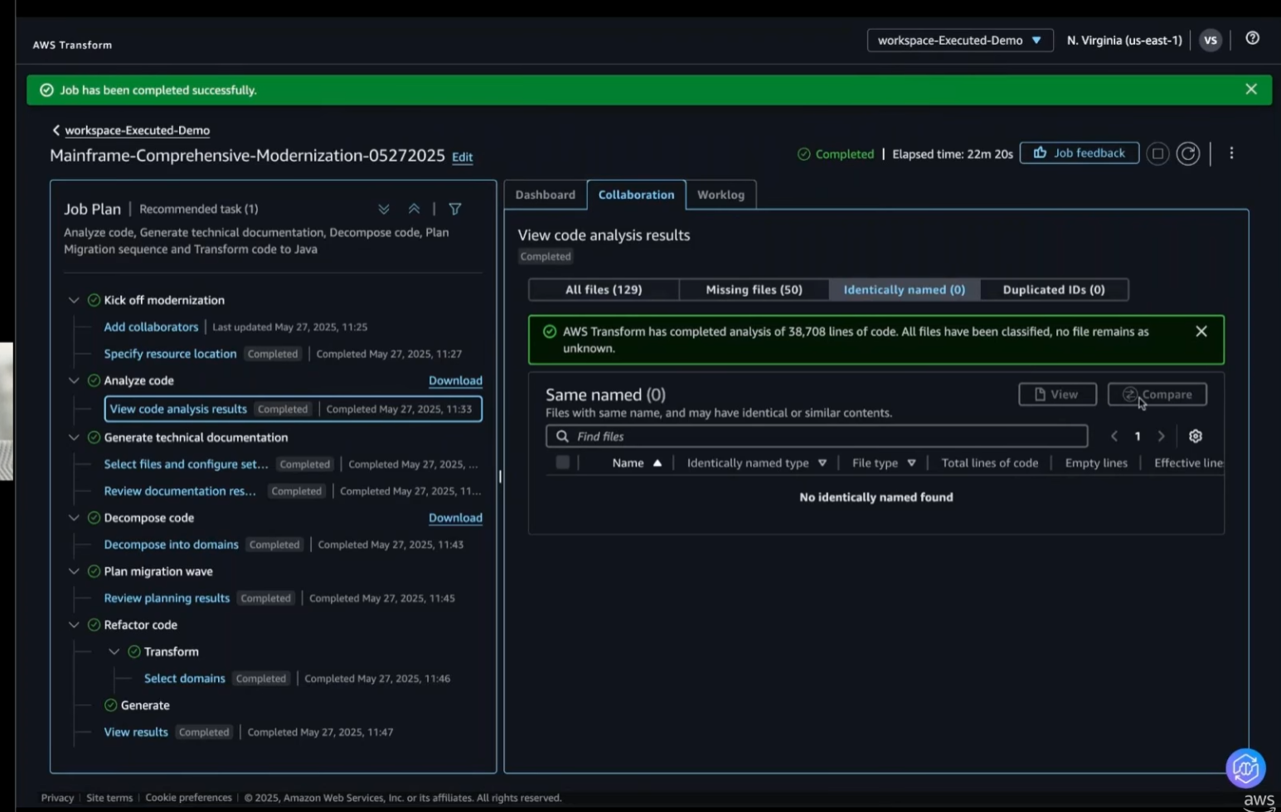
Solve missing puzzle

Slide 8
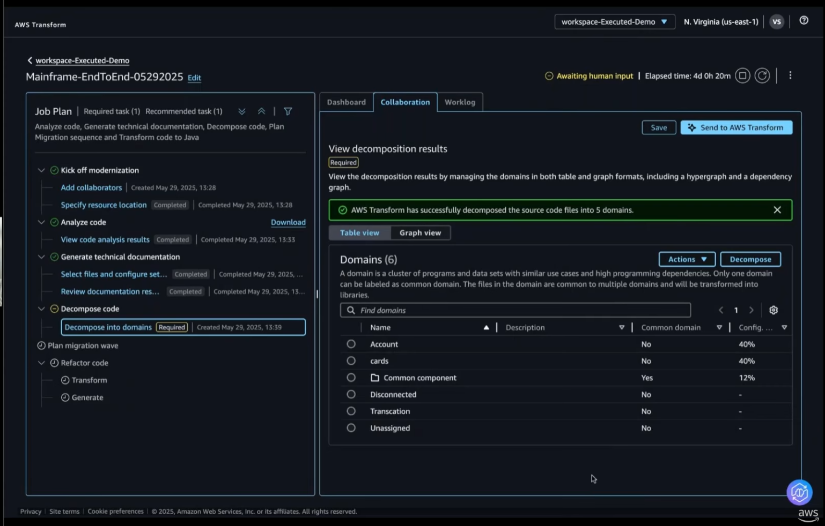
Human in Loop | Job Plan

Slide 9
Automated Refactoring & "Reforge"
Automated Refactoring & "Reforge"
Refactoring: The service automatically converts COBOL code into functionally equivalent Java code [14:20].
Reforge (Key Feature): A multi-agent process called "Reforge" takes the initial Java conversion and restructures it to make it more readable and idiomatic (Java-like) rather than just a line-by-line translation of COBOL. It simplifies complex loops and adds human-readable comments to ensure the code is maintainable long-term [14:38].

Slide 10
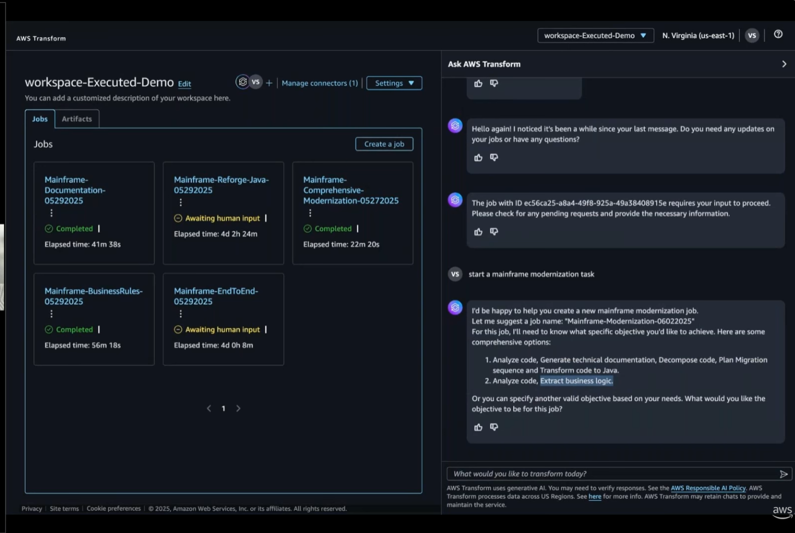

Slide 11
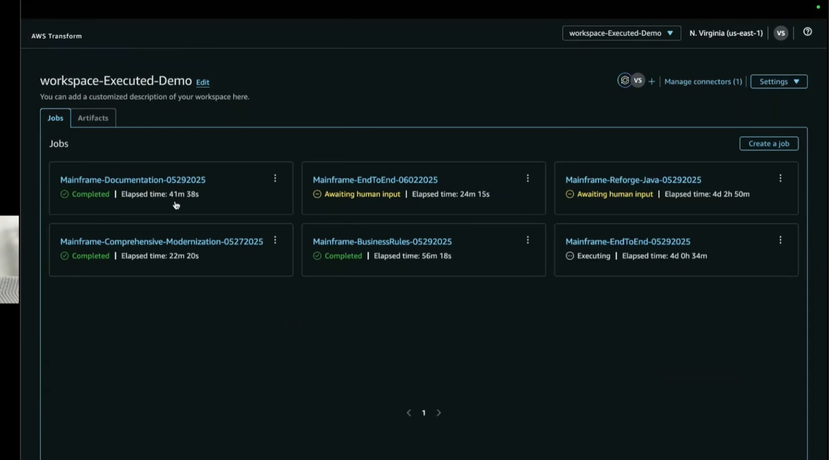

Slide 12
User Experience & Interface
Chat Interface: Users interact with the tool using natural language (e.g., "Start a mainframe modernization task") to negotiate a job plan and select objectives [15:55].
Unified Workspace: The platform provides a collaborative environment where multiple users (contributors, approvers) can view progress, approve steps, and visualize dependency graphs [19:14].
Human-in-the-Loop: The system is designed to pause for human judgment at critical points, such as confirming the decomposition strategy or reviewing the migration plan [06:20].

Slide 13
TransformX

Slide 14
LangGraph for agent orchestration
AST parsers for code analysis
Langfuse for observability

Slide 15
TransformX
Architecture Comparison
Aspect | TransformX | AWS Transform (atx)
Orchestration | LangGraph (you control) | Proprietary (AWS black box)
LLM | Your choice (Claude API, Ollama, etc.) | Bedrock (likely Claude)
Trigger | Manual/CLI/CI pipeline | Manual/CLI/CI pipeline
Scope | Broader transformations | Broader transformations
Learning | Langfuse + custom RAG | Built-in knowledge items
Cost | API tokens (or free with local LLM) | Agent minutes (paid)
Customization | Full control | Limited to their framework
Observability | Langfuse (your setup) | AWS billing dashboard

Slide 16
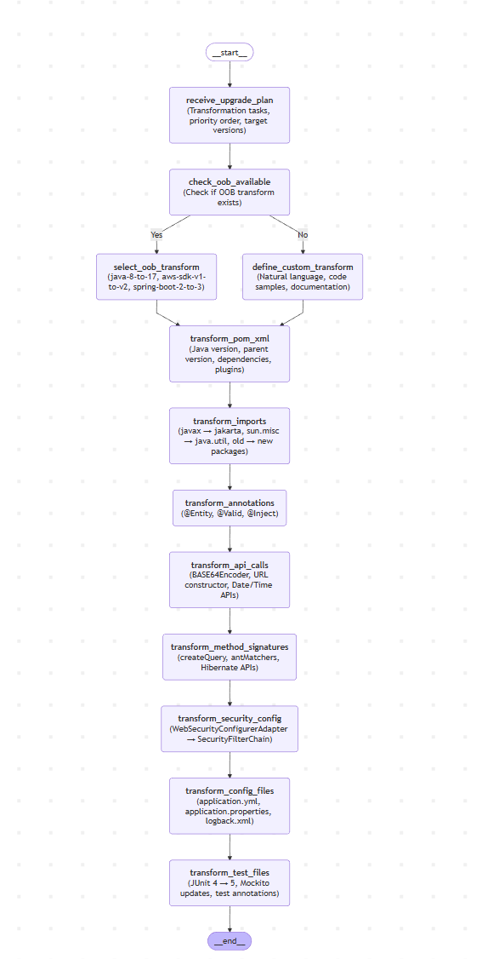
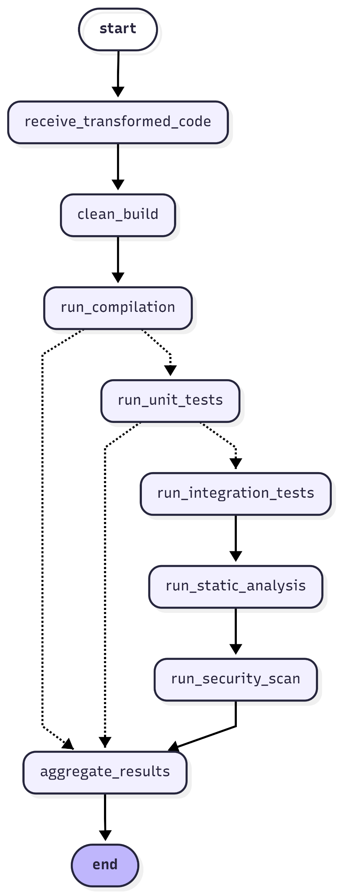
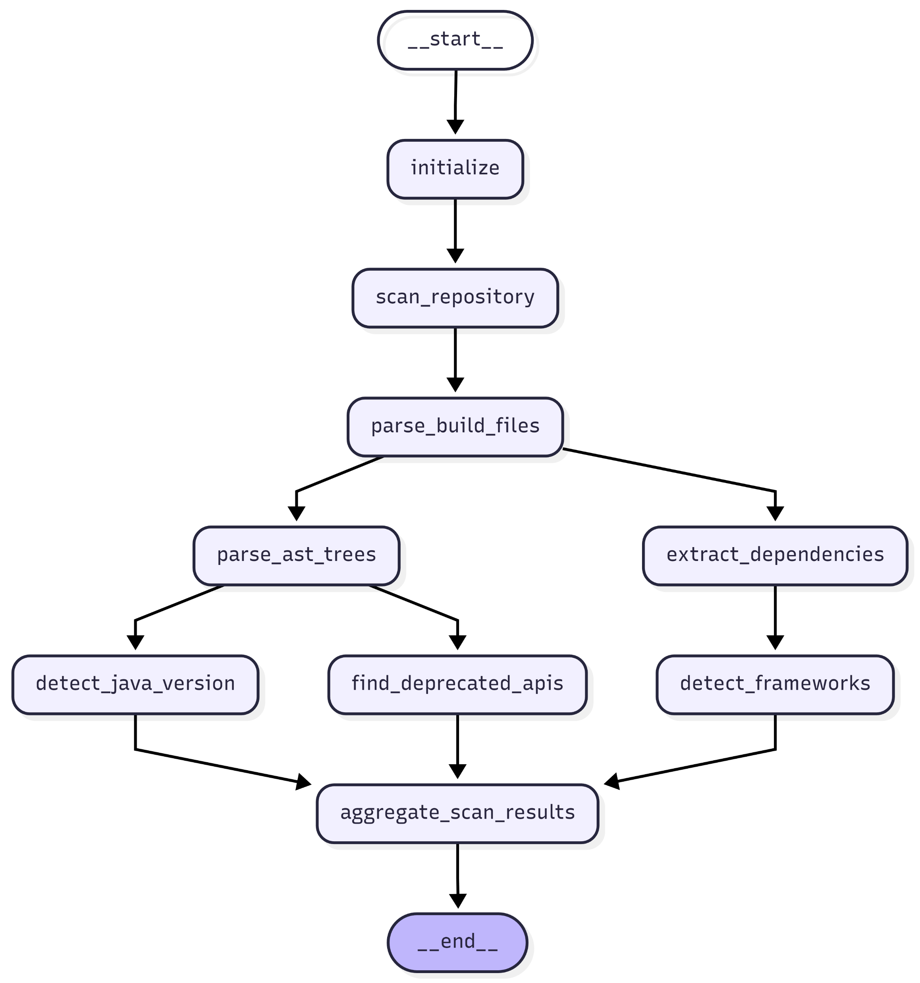
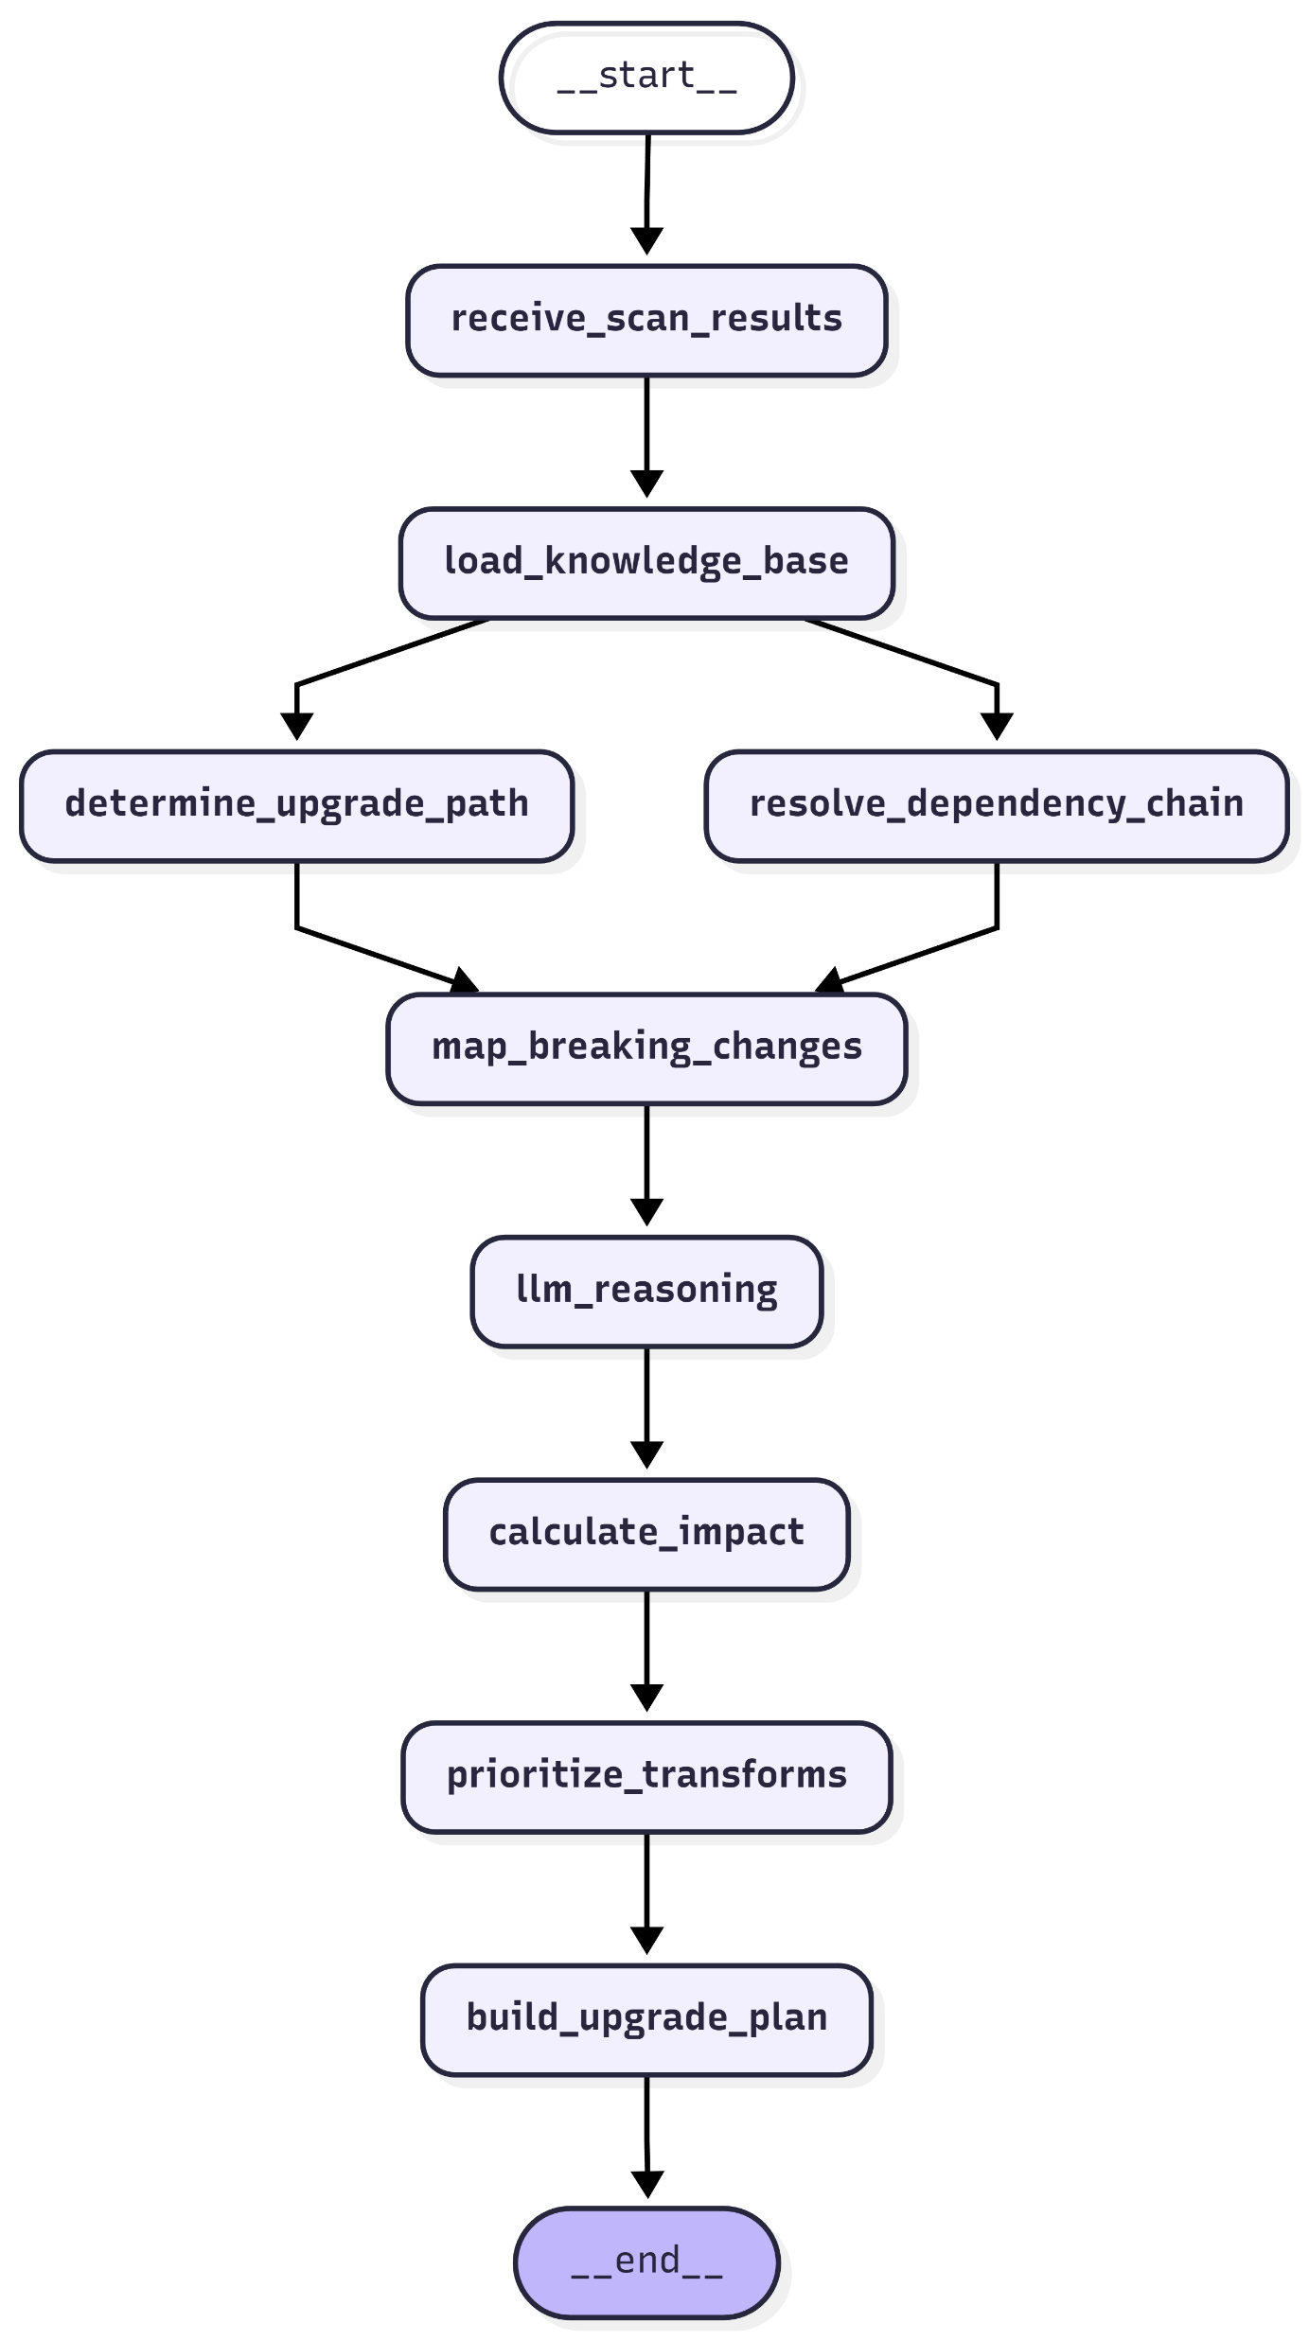
Multi Agent Architecture
Validator Agent
Scanner Agent
Planner Agent
Transformer Agent

Slide 17
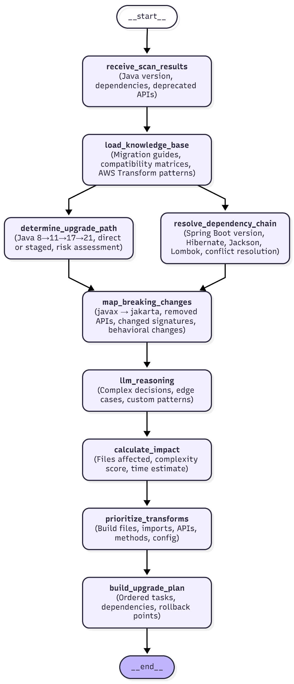
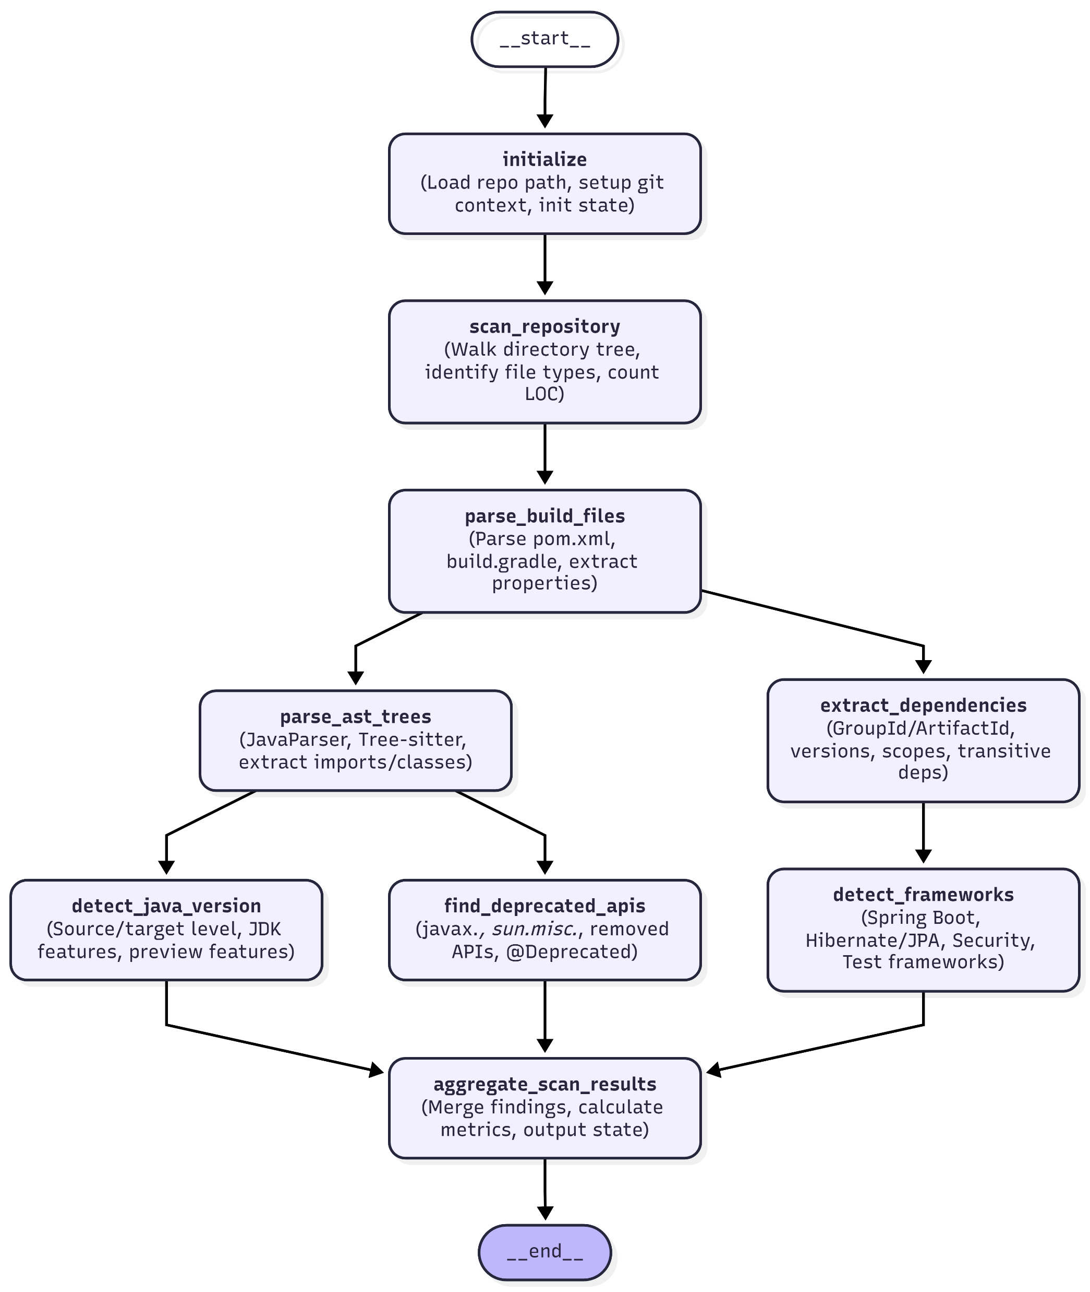
Planner Agent
Scanner Agent

Slide 18
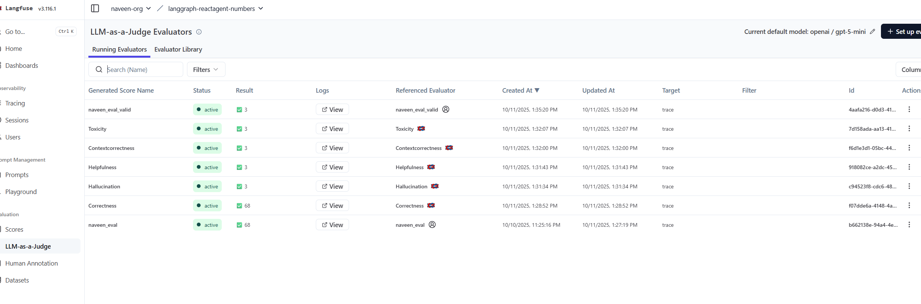
Langfuse : For Evals and Observability LLM-as-a-Judge Pattern

Slide 19
